Slide 1
POWER BI PROJECT REPORT
URBAN PULSE
SMART CITY MOBILITY INTELLIGENCE PLATFORM
Star schema data model • Executive Dashboard • Weather Analytics Dashboard
Four datasets • 111,000+ rows • 2006–2024
July 2026

Slide 2
AGENDA
What we'll cover
01
Project Objective
02
Data Sources
Why this model exists and who it serves
Four datasets, ~111K rows, 2006–2024
03
Star Schema
04
Executive Dashboard
Dim_Date at the centre of three fact tables
Operational KPIs for transportation performance
05
Weather Analytics
06
Insights & Next Steps
Long-run climate trends behind mobility
What the data shows, and where to take it
Urban Mobility & Climate Analytics Platform
2

Slide 3
PROJECT OBJECTIVE
One model, four data domains
Stakeholders needed to move between demographic context, real-time-style mobility conditions, scheduled transport performance and historical weather — without switching tools. The project consolidates all four into a single Power BI star schema built around a shared Date dimension.
PROJECT AT A GLANCE
4
Source datasets unified
~111K
Consolidate 4 datasets into one star schema
Share one Date dimension across all facts
Total rows across all sources
3
Deliver an Executive Dashboard for leadership
Deliver a Weather Analytics Dashboard for planning
Fact tables (Weather, Mobility, Transport)
2
Dashboards delivered
Urban Mobility & Climate Analytics Platform
3

Slide 4
DATA SOURCES
Four datasets feeding the model
Dataset | Coverage | Rows | Feeds
Demographic Dataset | 38 districts, Tamil Nadu | 38 | Reference / district context
Mobility Dataset | 5-min intervals, 1–18 Mar 2024 | 5,000 | Fact_Mobility
Transportation Data | Weekly boardings, Jun 2013–Jul 2014 | 10,000 | Fact_Transport
Weather History | Hourly readings, 2006–2016 | 96,453 | Fact_Weather
Together the sources span roughly 111,000 rows and cover 2006–2024, giving the model both long-run climate history and near-term mobility and demand detail.
Urban Mobility & Climate Analytics Platform
4

Slide 5
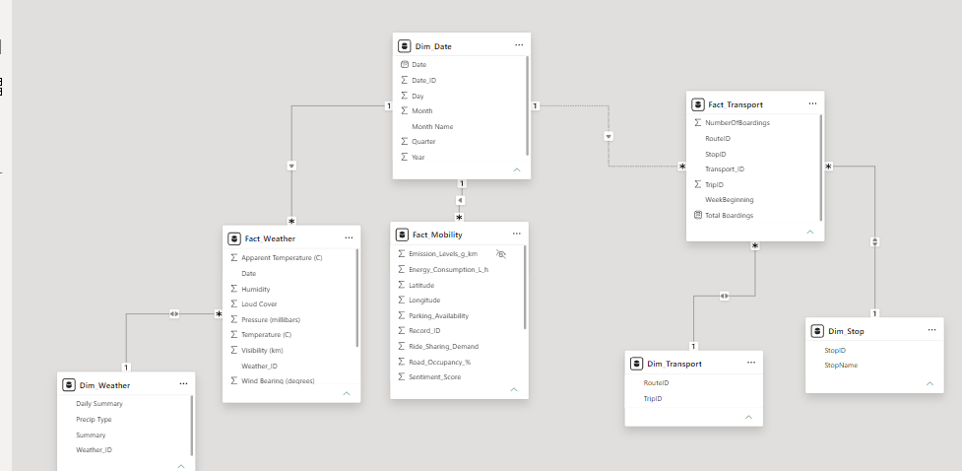
DATA MODEL
Star schema: one Date dimension, three facts
HOW IT'S BUILT
Dim_Date
Shared Year / Quarter / Month / Day hierarchy
Fact_Weather
Temperature, humidity, pressure, visibility, wind
Fact_Mobility
Vehicle count, traffic speed, emissions, sentiment
Fact_Transport
Boardings by route, stop and trip
Urban Mobility & Climate Analytics Platform
5

Slide 6
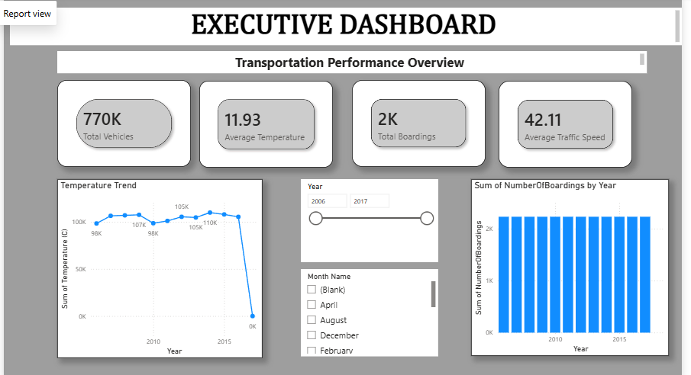
DASHBOARD 1
Executive Dashboard
Transportation performance overview — filterable by Year and Month
770K
Total vehicles
11.93°C
Avg. temperature
2K
Total boardings
42.11 km/h
Avg. traffic speed
Urban Mobility & Climate Analytics Platform
6

Slide 7
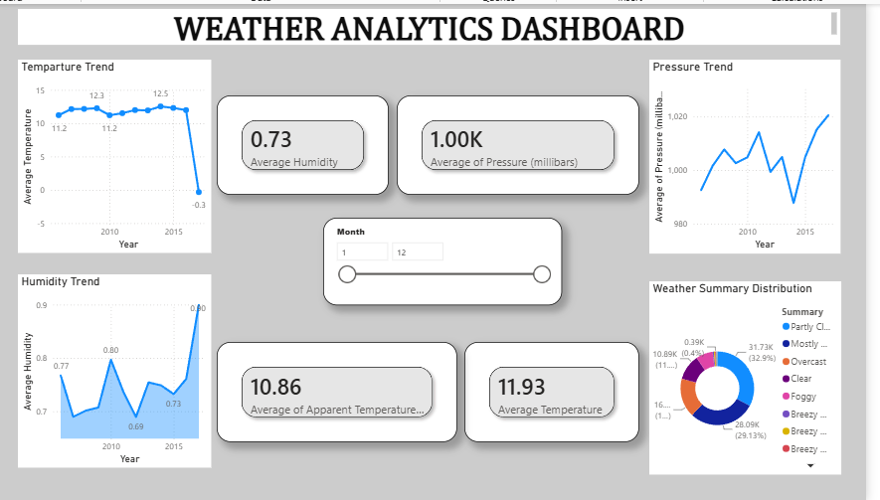
DASHBOARD 2
Weather Analytics Dashboard
Long-run climate trends behind mobility — filterable by Month
0.73
Avg. humidity
1.00K mb
Avg. pressure
10.86°C
Avg. apparent temp.
11.93°C
Avg. temperature
Urban Mobility & Climate Analytics Platform
7

Slide 8
FINDINGS
Key insights
Ridership is stable
Traffic runs hot
Boardings hold near 2K/year across the observed range — demand looks driven by route/stop coverage more than season.
63% of mobility readings are High traffic condition; average road occupancy exceeds 54%.
Climate is stable
Cloud cover dominates
Temperature, pressure and humidity all move within a narrow historical band (2006–2015) — no clear long-run drift.
Partly/Mostly Cloudy account for ~62% of all hourly weather readings.
Demand is concentrated
Data caveat
A handful of stops (King William St, Grenfell St, Paradise Interchange) carry a disproportionate share of boardings.
The year-end dip on both Temperature Trend charts is a partial-period artefact, not a real climate signal.
Urban Mobility & Climate Analytics Platform
8

Slide 9
Thank you
Urban Mobility & Climate Analytics Platform
10

